Slide 1
Problem-Setting On Topcoder
Xiao Mao
Massachusetts institute of technology

Slide 2
To start with, I will give a brief introduction to the procedures of problem-setting on Topcoder.
I have no connections to Topcoder. THIS IS NOT AN ADVERTISEMENT.

Slide 3
MPSQAS
Member Problem Submission and Quality Assurance System
Apply for writer/tester
Propose and edit problems

Slide 4
What contests can you write problems for?
As much as I know, SRMs and TCOs.
You may not participate in any contest in which problems you wrote are being used. (https://www.topcoder.com/community/member-programs/algorithm-problem-writers/)
Also, you may not publicize that you are the writer.

Slide 5
How can I be a writer?
Eligibility: (https://www.topcoder.com/community/member-programs/algorithm-problem-writers/)
18+ years old
Topcoder Algorithm rating of at least 1500
Use the writer application page on MPSQAS. You need to send an email to TAlgorithm@topcoder.com since MPSQAS doesn’t send automatic notifications. (https://www.topcoder.com/community/member-programs/algorithm-problem-writers/))
Contact admins or be contacted by them(cgy4ever messaged me). They will give you the directions. (cf. UOJ)

Slide 6
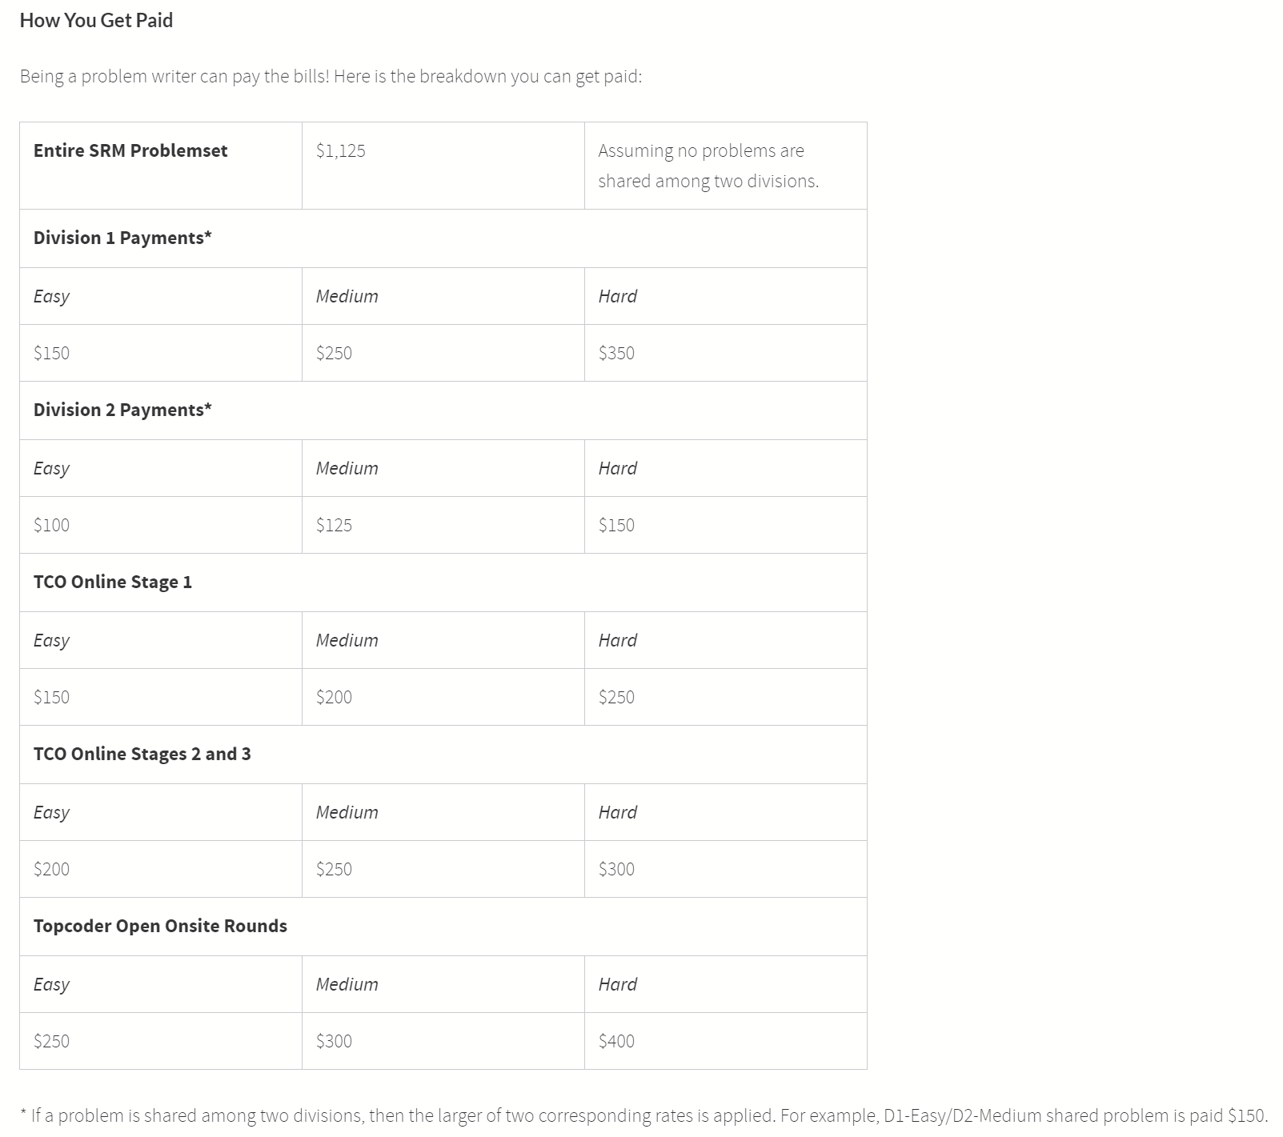
https://www.topcoder.com/community/member-programs/algorithm-problem-writers/

Slide 7
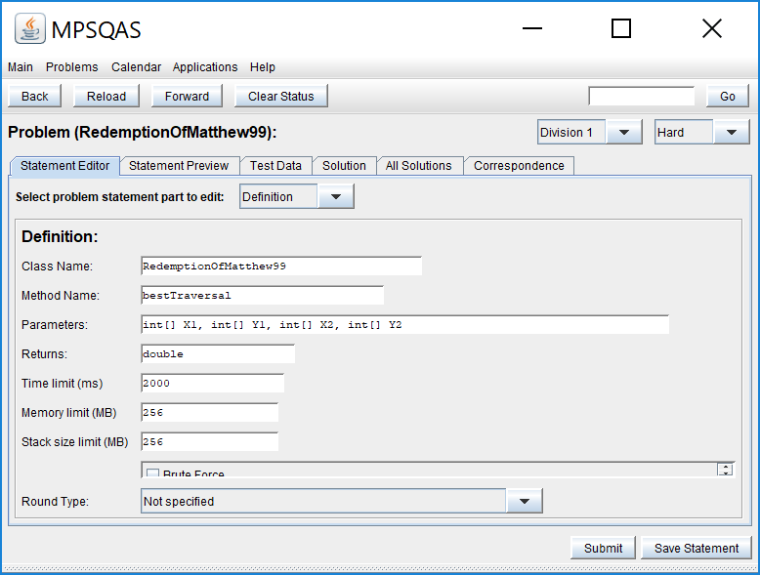
Statement editor

Slide 8
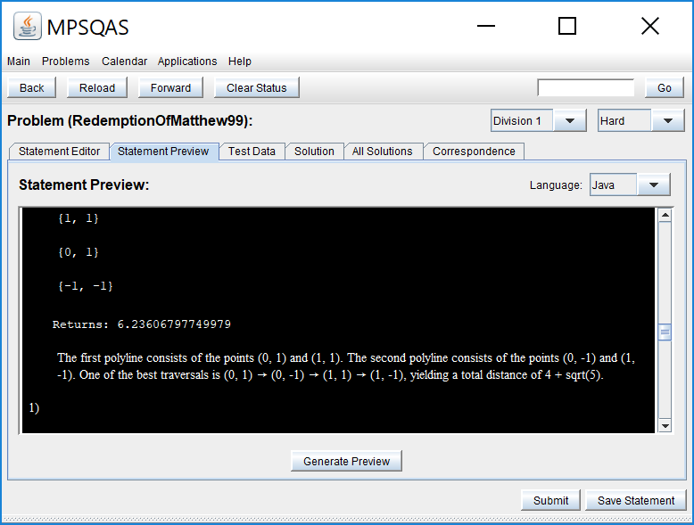
Statement Preview

Slide 9
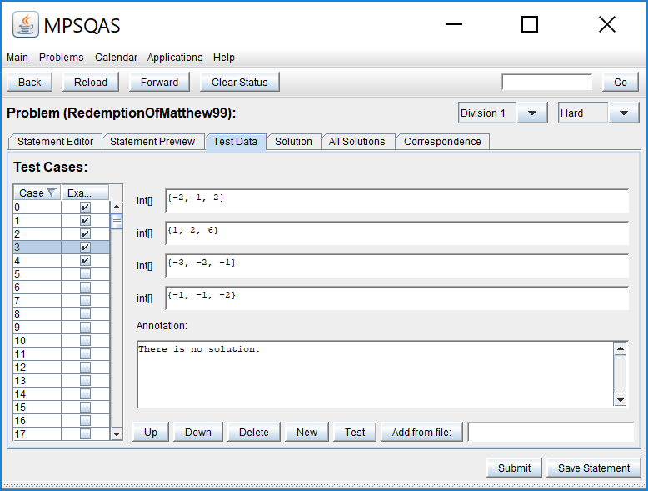
Test Data
You can either add them one by one or
add a batch of data from a file.
However, arrays can’t have more than
2,500 elements.

Slide 10
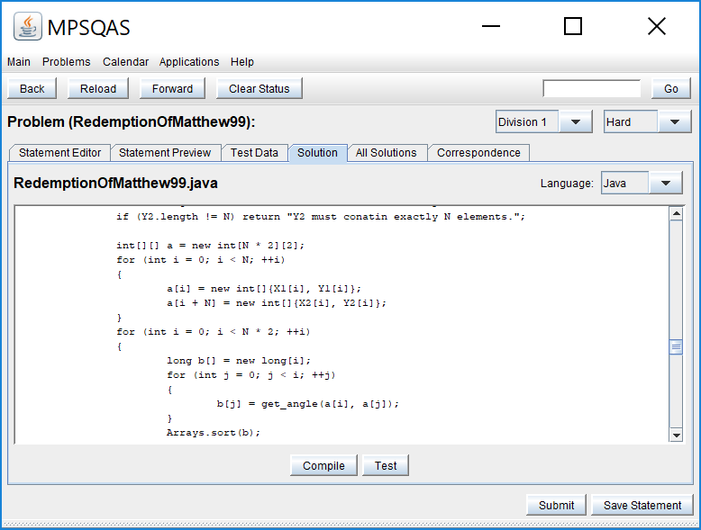
Solution
The standard solution should be in Java(☹).
The solution should also include
Validator and Checker(if needed).
“Test” will also validate test data.

Slide 11
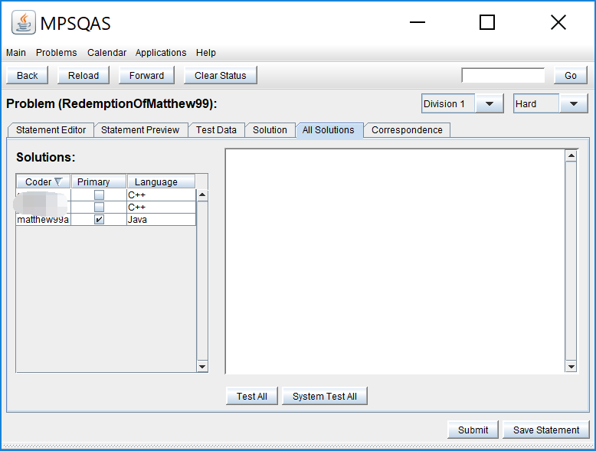
All solutions

Slide 12
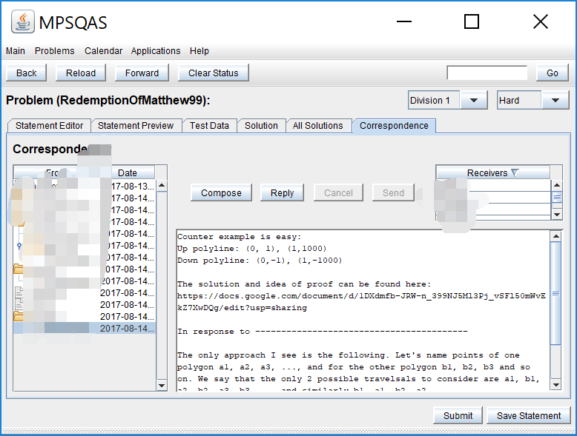
Correspondence

Slide 13
Solution
A solution must be proved correct or very likely correct for ALL test cases.
It must fit in the time limit with a large margin(i.e worst-case run time below a fraction of the time limit).

Slide 14
Checker
For some special tasks, the correctness of an output isn’t obvious. A checker is needed.
A checker must be proven to accurately or very likely report the correctness of ALL outputs.
For incorrect outputs, an explanation is preferred.

Slide 15
Validator
A validator validates inputs.
It must be proven to accurately or very likely report the validity of ALL inputs.
For incorrect inputs, an explanation is almost always needed.

Slide 16
Typically, writers code solutions, checkers and validators in separate files.
However, we do it in one file on Topcoder.
To further explain that, let’s introduce Java.

Slide 17
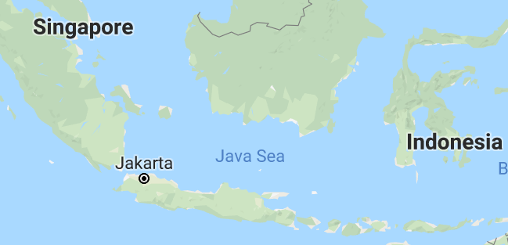
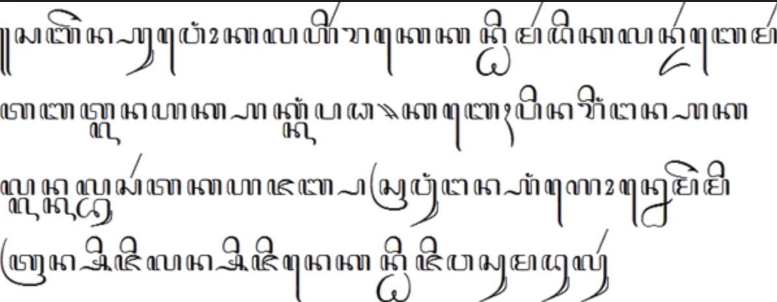
Java
As was mentioned, the standard solution should be in Java.
What is Java?
Its’ not a sea. It’s a language. ☺
It’s not Javanese. It’s a programming language. ☺

Slide 18
Java
For those who don’t know how to code in Java, a good way is to code in C++ first and then try to translate the code into Java.
How different is Java from C++?

Slide 19
C++
“g++ (filename).cpp –o (output file name)”
An executable file is generated
Run the executable file.

Slide 20
Python
Use the command “python (filename).py” to run.
No extra files are generated
The code itself is “executive” in some way.

Slide 21
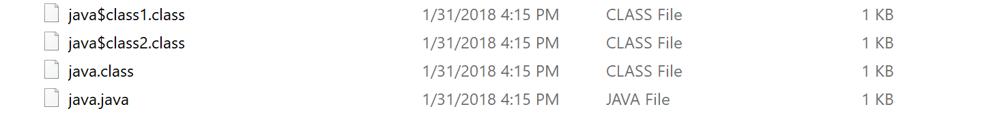
Java
“javac (filename).java”.
Files for classes are generated.
After javac, use “java (filename)” to run.
Unlike python, compilation is required.
Unlike C++. No executable files are generated. It’s possible to “interact” with the program in the black box.
Topcoder arena and MPSQAS are run on Java platform. Writing standard solution in Java makes things much easier.

Slide 22
Standard Solution
A standard solution on topcoder comprises a solution, a validator and sometimes a checker.
How does that work?

Slide 23
What happens when you run a Java program
A java program must contain a public class whose name is the same as the file’s.
By default, a public static void function named “main” will be called. If it doesn’t exist, there will be an error.
To receive input from the input stream, a reader class is needed. Similarly, to output to the output stream, a writer class is necessary.
However, on topcoder, things are a little bit wacky.

Slide 24
Java on Topcoder
In solution mode, the function given in the problem statements is called. It shall return a variable with required type and value.
In checker mode, a function named “check” is called. It shall return either an error message or an empty string when the output is correct.
In validator mode, a function named “checkData” is called(Like C++, Java is also case-sensitive). It shall return either an error message or an empty string in case the input is valid.
The mechanics don’t matter, since we are not the developers. ☺

Slide 25
How similar is Java and C++
“The language(Java) derives much of its syntax from C and C++, but it has fewer low-level facilities than either of them.” ---Java (programming language) Wikipedia
Mandarin, Cantonese, and Middle Chinese. (My own dialect, Xiang, develops from Ancicent Chinese)

Slide 26
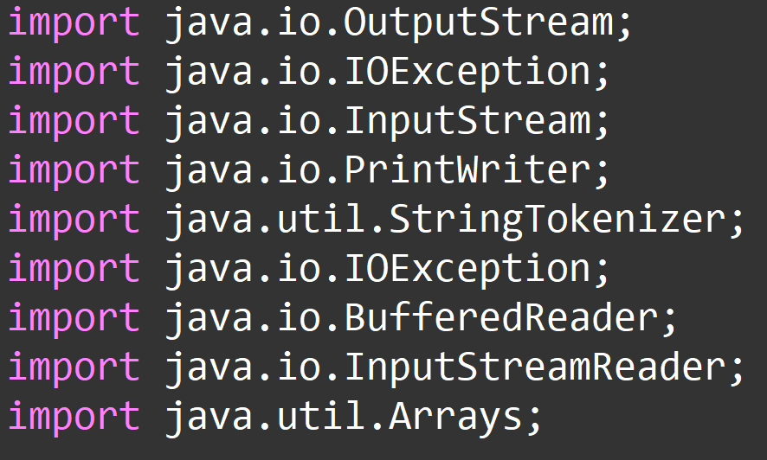
Libraries
C++: #include <bits/stdc++.h>
Java:

Slide 27
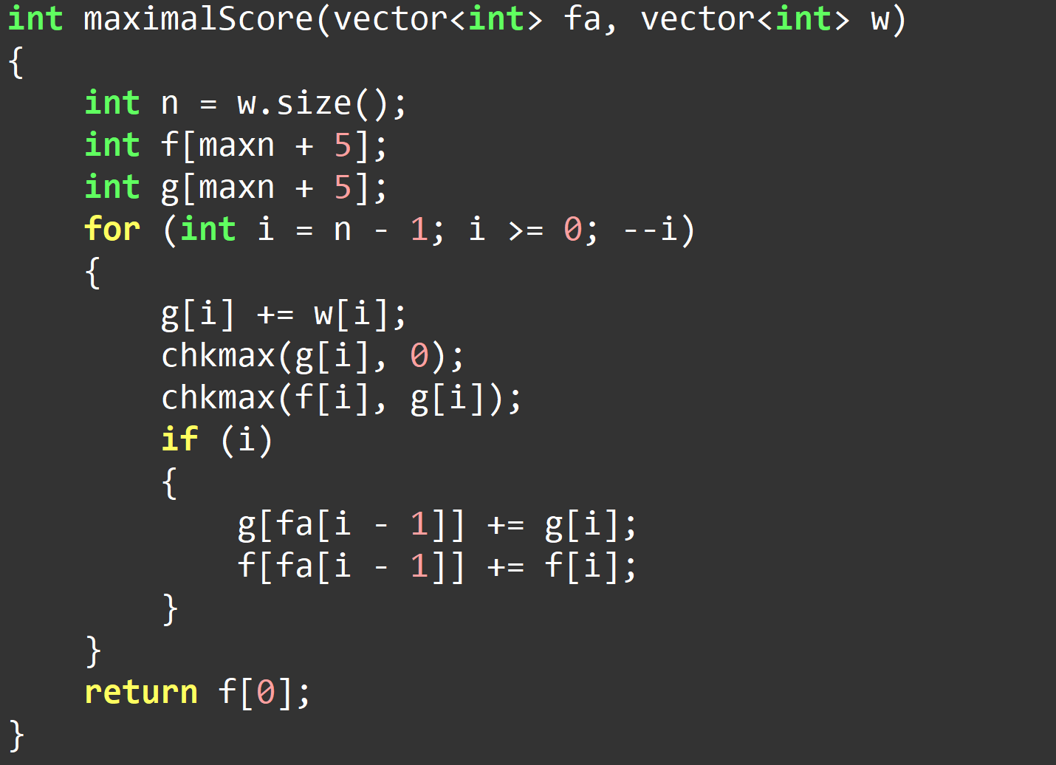
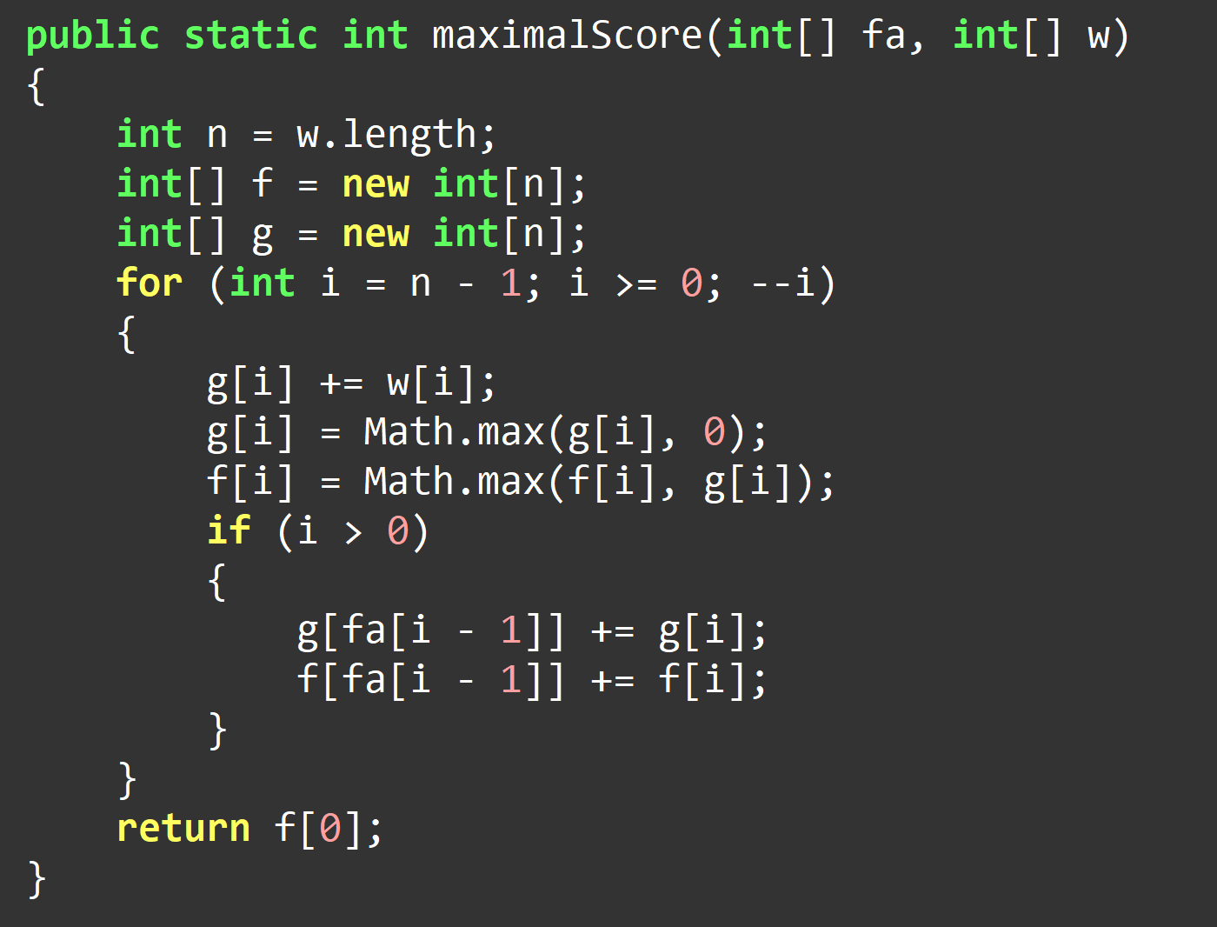
What differences can you find?

Slide 28
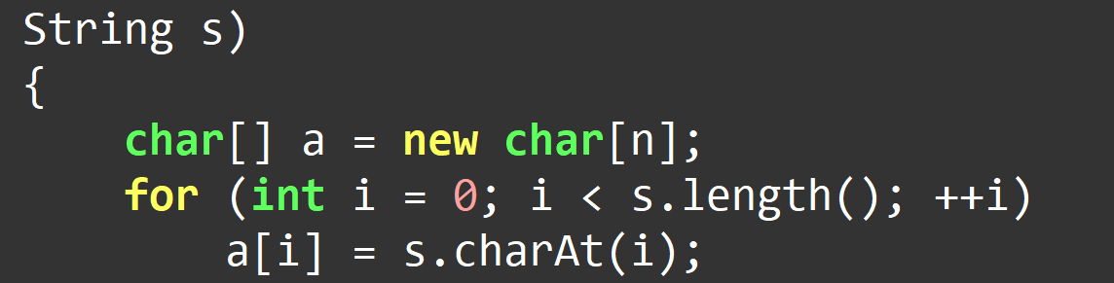
String in Java
You can’t modify a string in Java. To do so, you have to change it into an array of char.

Slide 29
Other differences
Overloading operators don’t exist in Java.
You can use big integers directly in Java. It can function as bitsets in C++.
“long” in java is 64-bit integer.
C++: a->x Java: a.x
C++: const Java: final
Generally a java program has a bigger constant factor than a C++ one.

Slide 30
Automatic Translator
Why doesn’t google translate support C++ to Java? ☹
Should an ideal automatic translation also reflect the conventions of the coders in different languages(e.g naming conventions)?
Translate other coders’ code into your conventions(not quite legit ☺).

Slide 31
Bonus Lecture: PS on Codeforces by Tommyr7

Slide 32
Contacted by Admin
In 2016, I became #4 on Codeforces and a target on Topcoder, the likes of which I had never been before (and haven’t topped ever since).
On March 2017, I was interviewed by Topcoder(https://www.topcoder.com/blog/interview-topcoder-member-matthew99a-xiao-mao-china/), in which I showed my intention to write tasks for Topcoder.
After CTSC, cgy4ever sent me an invitation on Codeforces. That’s how it all began.

Slide 33
Looking for Ideas
I reckoned that it wouldn’t be too hard for me to come up with a couple of ideas to occupy the easy problems. I decided to work on the hard ones on div1 first.
I had an idea for the 500-pointer, submitted it, and found my solution wrong.
I tweaked the problem a little bit, came up with another solution, stress-tested it and failed it.
I reduced the problem to a special case. Finally things were going my way.

Slide 34
Oops…Too Many Ideas
Apparently, my final version of the problem was a little bit too hard for a 500-pointer. It ended up the 1000-pointer.
Then I came up with a problem without an apparent solution. I worked on it for quite a while, and I found a really simple algorithm.
Despite the long time I spent on it, I submitted it as the 500-pointer because the final solution was not that difficult.
It was considered too complicated. I was informed that the 500-pointer should be something “simple for me”.
Clearly, I had two 1000-pointers vying for one slot. Interestingly, cgy4ever didn’t get stuck on either of them.

Slide 35
Two 1000-pointers
cgy4ever suggested that I could put one of my problems into TCO2C, which meant I had to advance on TCO2B.
I ranked #4 on TCO2B. One of my problems did end up in TCO2C. My rating soared to 3,101, which was 500 or so more than it is now.

Slide 36
The 500-pointer and others
It wasn’t long before I came up with another idea for the 500-pointer, and it was approved.
I had some ideas in my vault. I submitted one for div2 hard. Then I submitted another one for div1 easy. It turned out that it could be nerfed for div2 medium.

Slide 37
Div2 easy-LongLiveZhangzj
It turns out that the idea for div2 easy doesn’t have to be original, as long as it has a brilliant storyline.
The statements have obvious toad-worshipping references.
The problem simply asks you to implement what is stated.

Slide 38
TCO2C
It was finished before IOI.
A lot of people solved it, while tourist and petr didn’t. Both of them lost lots of rating.
xudyh mistyped 26 as 25 during upsolving.

Slide 39
SRM719
I had my horrible swan song on IOI. It was hard to let it go during my preparation of this SRM.
yanQval got #1. Egor and yutaka followed.

Slide 40
LongMansionDiv2 & LongMansionDiv1
Div2 medium & Div1 easy, respectively.
You are given an n by m grid. Boxes on each row have the same weight. Given two boxes, find a path between to minimize the sum of the values of boxes lying on the path.
n <= 50, m <= 1,000,000,000
1 <= All values <= 1,000
For the div2 version, the boxes are always the upper-leftmost one and the lower-rightmost one.
The dimensions of input are small because I don’t want to scare the participants.

Slide 41
Solution
Go vertically to some row x, then go horizontally, and then go vertically to the goal.
cgy4ever thought x must be between the rows the two ends are at.
One may think the row must be the one with minimal weight, which is incorrect as well.
Some tester hated the fact that I didn’t have the case when n != m in any of the samples. I added it later.

Slide 42
TwoDogsOnATree
Div2 hard
Given a tree with n nodes, edges have weights. Find two non-intersecting paths to maximize the xor-sum of weights of all edges lying on either of the paths.
n <= 1,000
0 <= weights < 1,024

Slide 43
Solution
Calculate the xor-sum from the root to each vertex. Denote the sum for vertex x as S[x].
The answer is the max value we can get by choosing 4 vertices and xor-summing their S’s up.
The dimensions of input are small because I want to make the problem easier.

Slide 44
OwaskiAndTree
You are given a tree with n vertices. Each vertex is assigned a value, which can be both positive or negative. You can walk the tree in the following way:
1. You enter the tree at the root.
2. You can choose an unvisited vertex adjacent to a visited one and visit it.
3. You can leave at any time
4. Your initial score is 0. Once you visit a vertex, the value assigned to it is added to your score. If your score becomes negative afterwards, it will change back to 0.
Maximize your final score.
1 <= n <= 1,000
-1,000,000 <= values <= 1,000,000

Slide 45

Solution
The main idea is that, if instead of changing the score to 0 when it becomes negative, you can do it anytime you want, the answer doesn’t improve.
Only the last time the score is changed to 0 matters.
Visited vertices always form a tree.
On the last time the score is changed to 0, the visited vertices are T.
When the tour ends, the visited vertices are T’.
Only vertices in (T’ – T) count to the answer.
Any (T, T’) satisfying $T⊂T′$ is OK.
DP on a tree.

Slide 46
TCO2C-hard: TreasureOfWinedag
You are given a string s with lowercase English letters. Split the string into k non-empty substrings. Minimize the sum of the number of different letters in each substring.
|s|, k <= 100,000

Slide 47
Solution
dp[i][j]: answer for splitting the prefix of length i into j parts
dp[i][1]: the number of different characters; dp[i][i]: i
dp[i][j + 1] >= dp[i][j]
There are only 26 different characters.
Only 26 segments: for 0 <= k < 26, j such that dp[i][j] = j + k
next[i][j]: the next position after i at which the letter is j.
Transfer in O(26 * 26) time.
Trivia: I had a hard time dealing with data generation.

Slide 48
RedemptionOfMatthew99
There are two polylines in the plane. Each polyline consists of N vertices. The first polyline lies strictly above the x axis and the second polyline lies strictly below the x axis.
Each polyline goes from the left to the right.
Additionally, the points of the polylines are placed so that:
If we connected the first and the last vertex of the first polyline to the point (0, 10^10000), we would get the boundary of a convex polygon P1.
If we connected the first and the last vertex of the second polyline to the point (0, -10^10000), we would get the boundary of a convex polygon P2.
Finally, the 2N given points are placed so that no three of them are collinear.
A traversal is a sequence of 2N points that has the following properties:
It contains each vertex of each polyline exactly once.
Two consecutive points in the traversal cannot belong to the same polyline.
The line segment that connects two consecutive points in the traversal cannot intersect the polygons P1 and P2.
The length of the traversal is the sum of Euclidean distances between consecutive points in the traversal.
Find the traversal with minimal length.
1 <= n <= 1,000. Absolute values of coordinates don’t exceed 1,000,000,000.

Slide 49
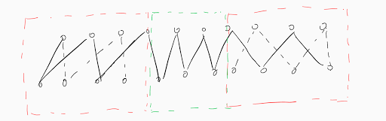
Solution
Picture by cgy4ever

Slide 50
Proof
An arc intersected by another one on the same direction.
An arc intersected by another one on the opposite direction.

Slide 51
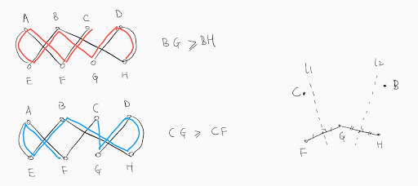
Proof ctd.
Picture by cgy4ever

Slide 52
Bibliography
https://www.topcoder.com/community/member-programs/algorithm-problem-writers/)
https://en.wikipedia.org/wiki/Java_(programming_language)

Slide 53
Bonus Lecture: about MIT

Slide 54
What is MIT?
Massachusetts Institute of Technology. Institute, not university(wrong on the name card ☹)!
Situated at Cambridge, MA, USA. Boston is on the other side of Charles River.
Founded in 1861. Campus in Cambridge est. 1916.
Motto: Mens et Manus(Mind and Hand)

Slide 55
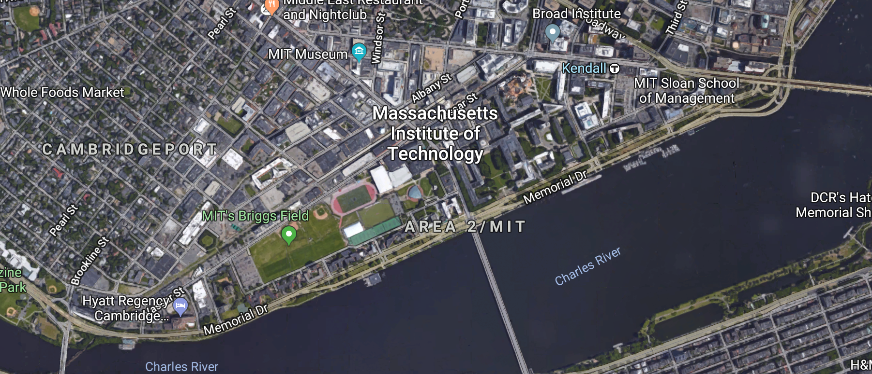
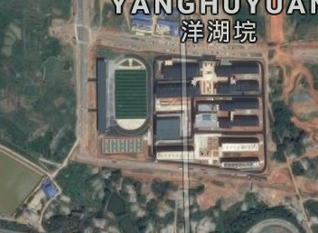
How big is the campus

Slide 56
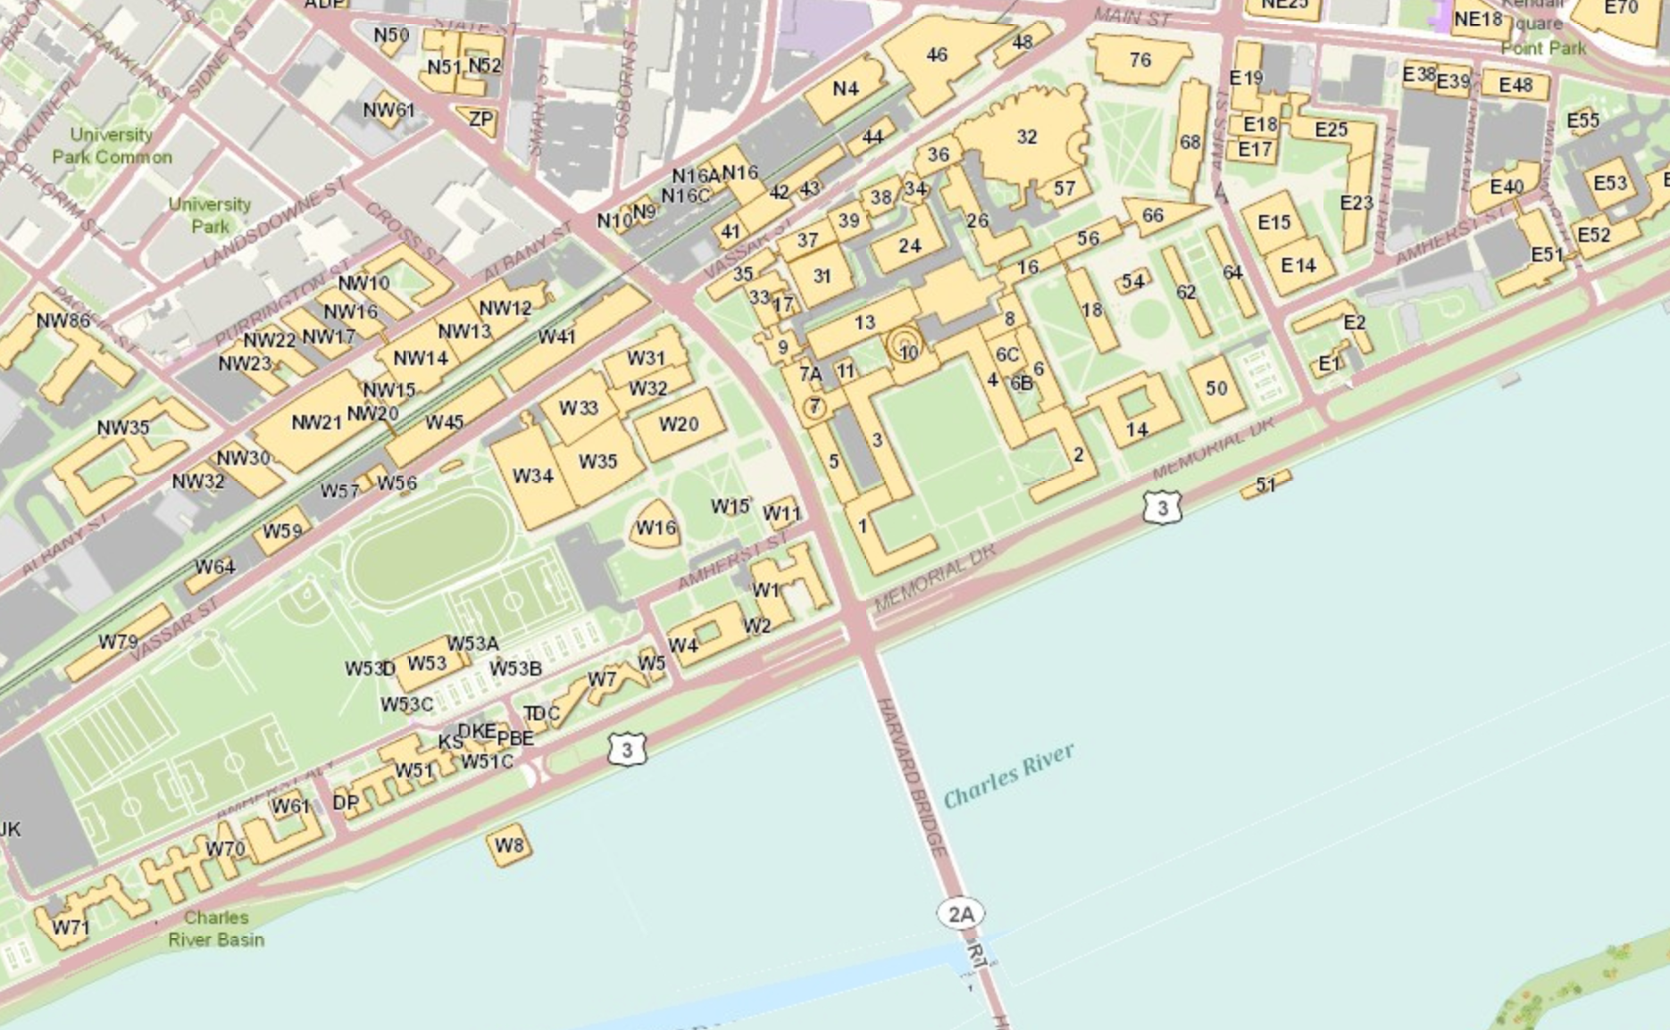
Building No. & Course No.

Slide 57
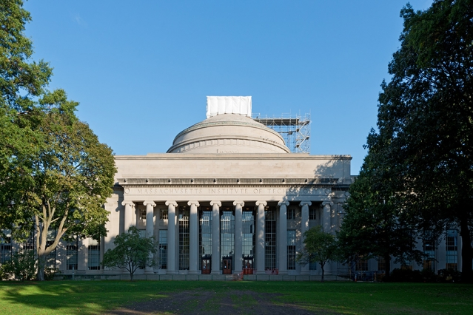
Building 10: Great Dome
http://news.mit.edu/sites/mit.edu.newsoffice/files/styles/news_article_image_top_slideshow/public/images/2013/20130214103501-10.jpg?itok=Qb72mM3t

Slide 58
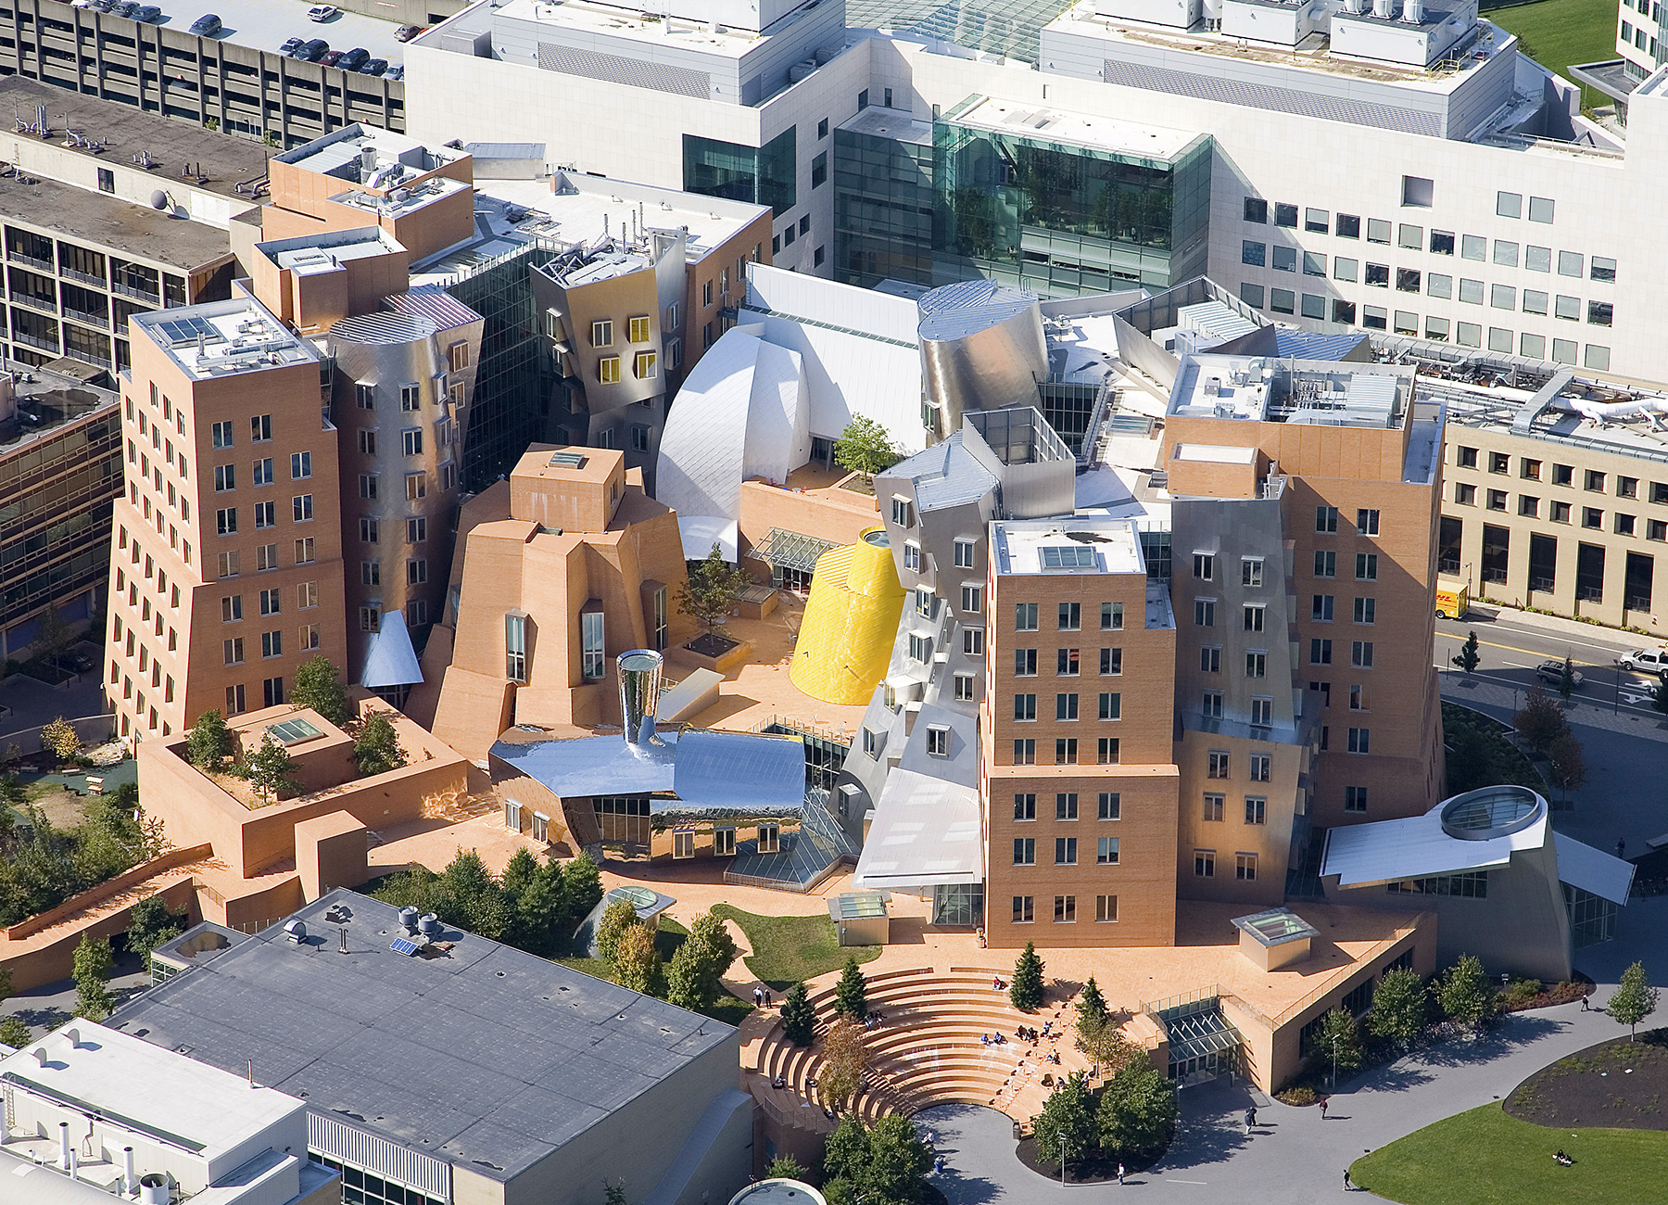
Building 32: Ray and Mario Stata Center
http://www.inquiriesjournal.com/article-images/uid-2397-1413000981/46588d.jpg

Slide 59
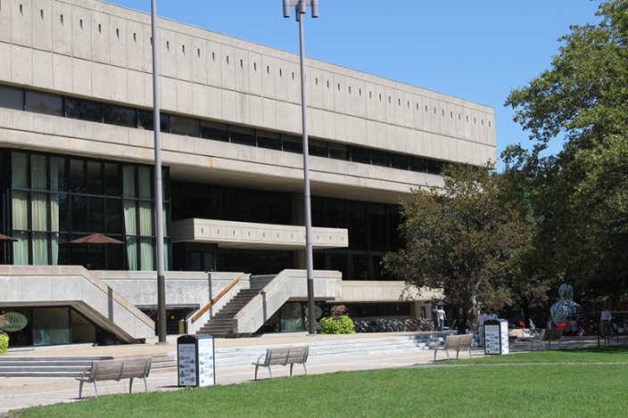
Building W20: Stratton Student Center
https://listart.mit.edu/sites/default/files/styles/slideshow/public/Stratton%20Student%20Center.jpg?itok=UKxbcFou

Slide 60
Courses
Electrical Engineering and Computer Science (Course 6)
Mathematics (Course 18)
Advanced Algorithms(6.854) 6: course 6

Slide 61
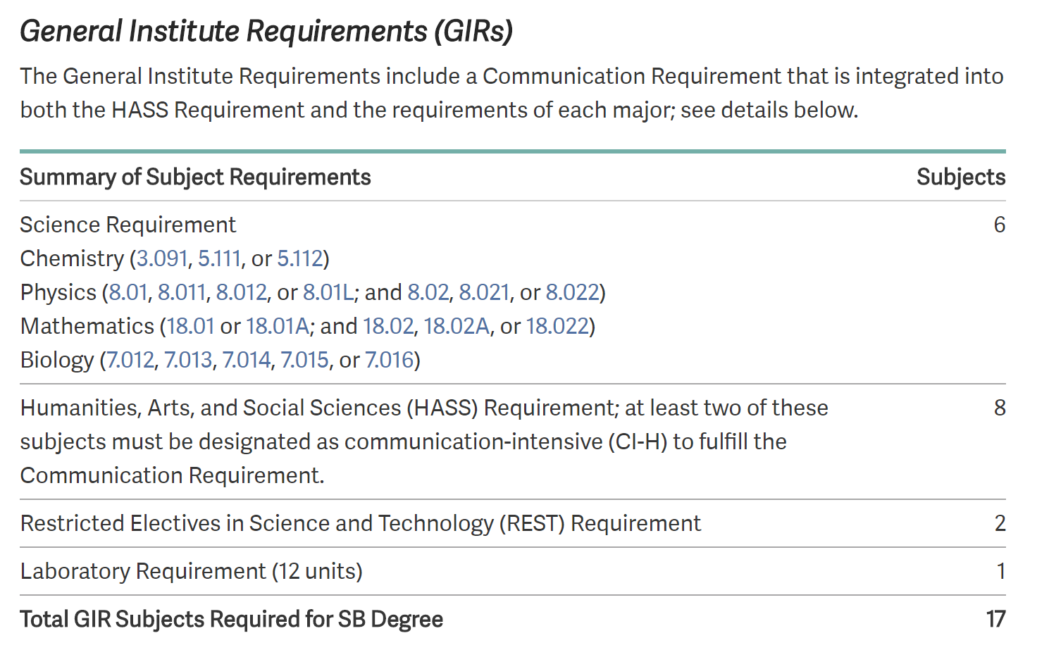
General Institute Requirements
http://catalog.mit.edu/mit/undergraduate-education/general-institute-requirements/

Slide 62
Physical Education Requirement
Swimming requirement, plus four physical education courses for eight points(http://catalog.mit.edu/mit/undergraduate-education/general-institute-requirements/).

Slide 63
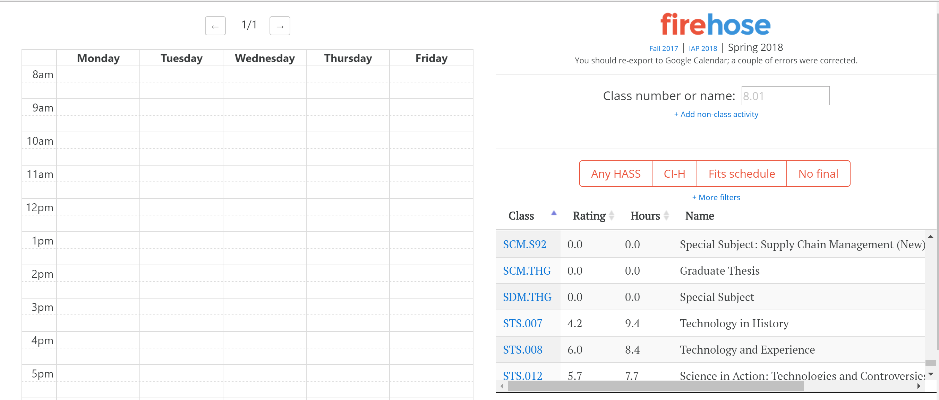
Firehose

Slide 64
Freshman Grading
“In the first semester and the January Independent Activities Period (IAP) freshmen are graded on a Pass or No Record basis in all subjects they take, where P (passing) means C- or better performance. Freshmen earn no credit for subjects with D and F grades.”
“In the second semester, freshmen are graded on an A, B, C or No Record basis. They continue to earn no credit for subjects with D and F grades.”
http://web.mit.edu/registrar/reg/grades/freshmangrading.html

Slide 65
ASEs

